Slide 1
Observer Model

Slide 2
First Steps
Open and run “observer.m” in MATLAB
Do not confuse with “observer.fig”
The Observer Model Interface will pop up
On the left, select the .xls file you would like to simulate (e.g., Yaw_rotation.xls)
You may need to double click on it
Click the red “Start Simulation” button
Once the “Please wait…” pop up goes away, click “Plot Data”

Slide 3
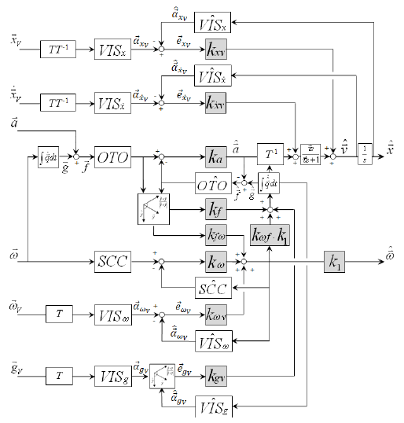
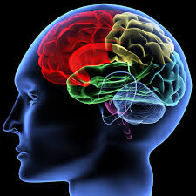
Complete Model

Slide 4
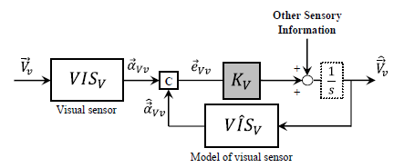
Feedback Loop Example

Slide 5
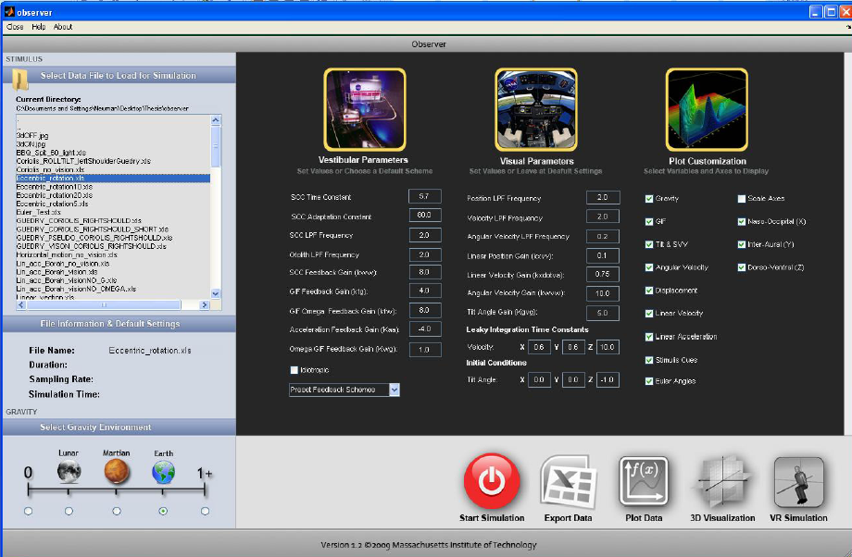
Observer Model Interface

Slide 6
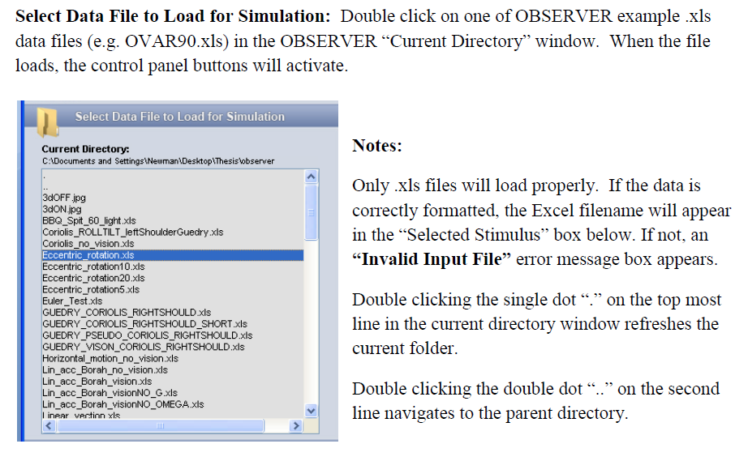
Loading a File

Slide 7
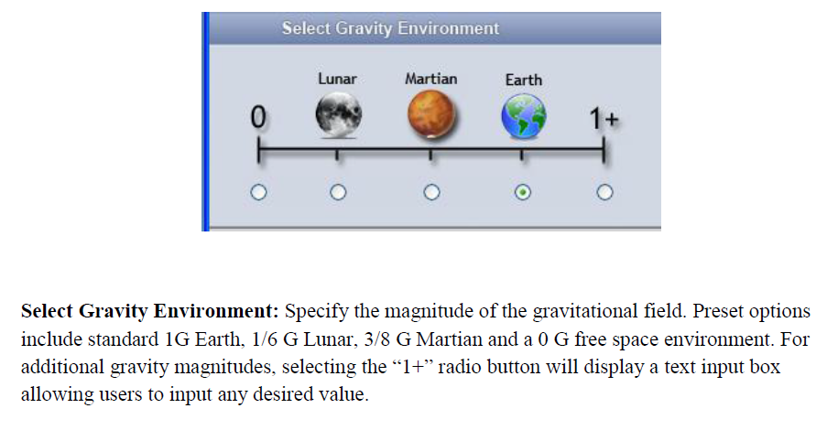
Select Gravity Environment

Slide 8
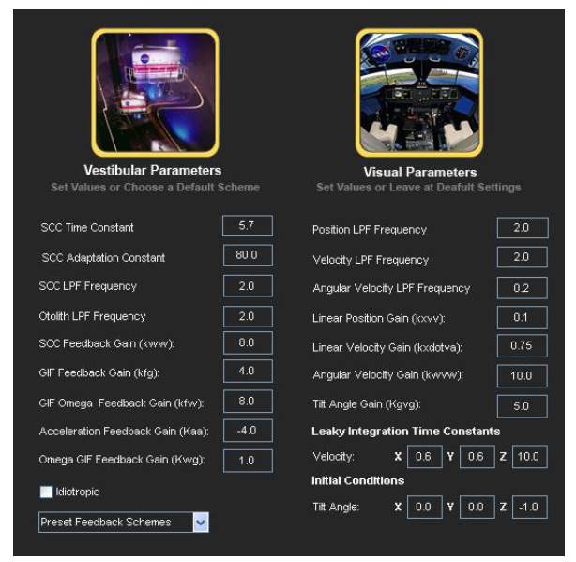
Set Visual/Vestibular Parameters
Generally avoid modifying these parameters

Slide 9
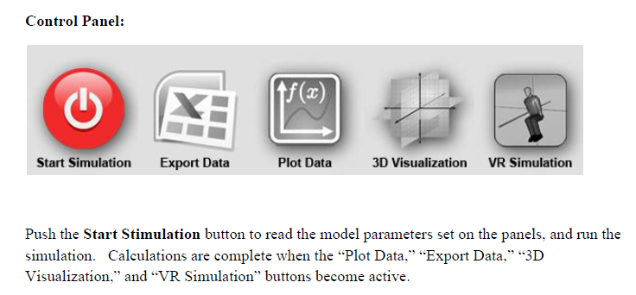
Running a Simulation
Press “Export Data” to send simulation outputs to an excel file
Press “Plot Data” to plot predicted responses
Press “3D Visualization” or “VR Simulation” for visual presentations

Slide 10
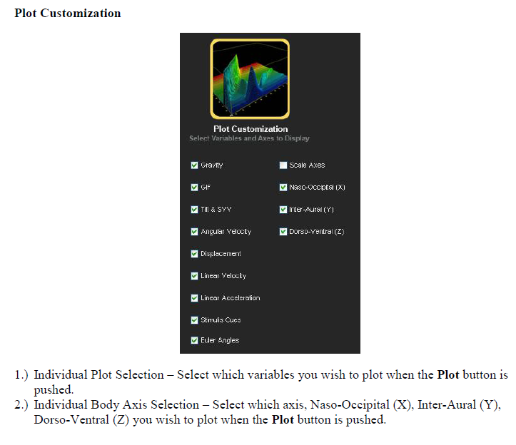
Plot Data

Slide 11
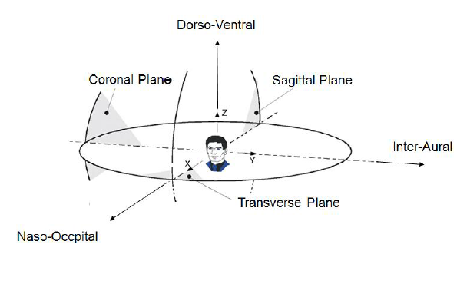
Head Fixed Coordinates

Slide 12
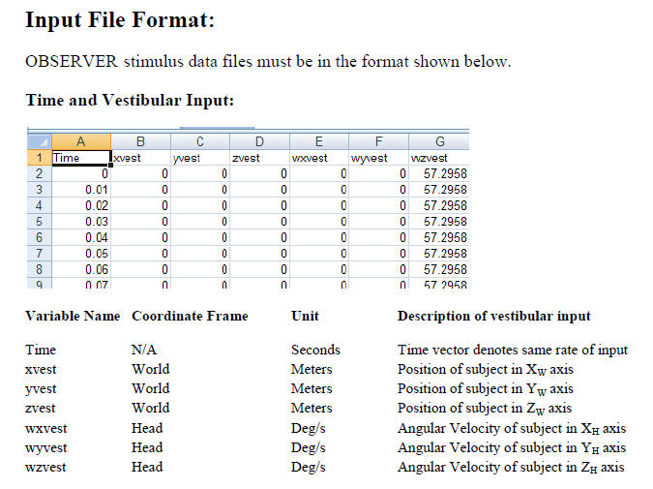
File Inputs 1

Slide 13
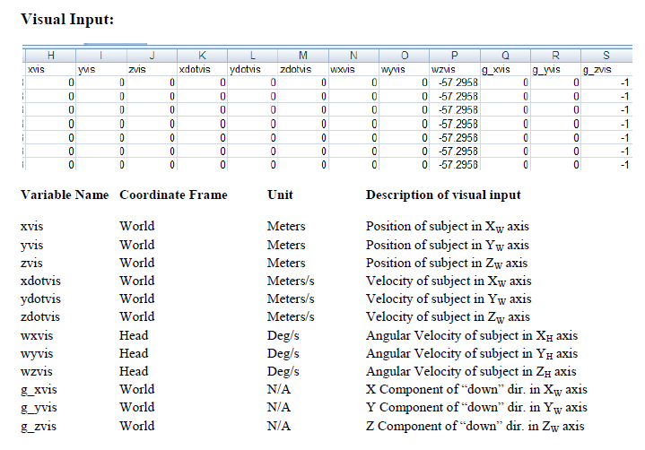
File Inputs 2

Slide 14
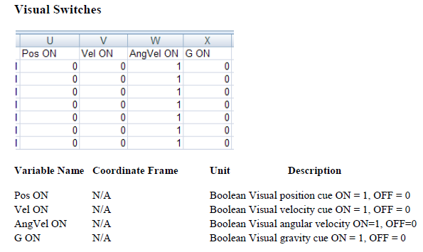
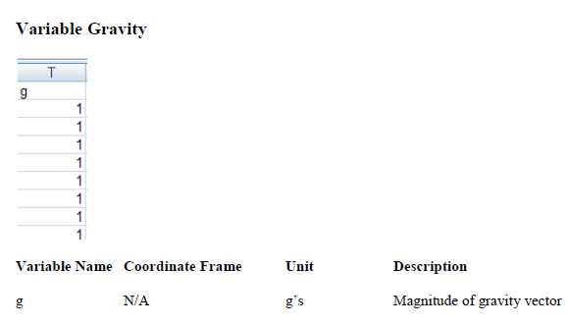
File Inputs 3

Slide 15
References
Newman, M.C., A Multisensory Observer Model for Human Spatial Orientation Perception, in Aeronautics and Astronautics. 2009, Massachusetts Institute of Technology: Cambridge, MA.
Merfeld, D.M., et al., A Multidimensional Model of the Effect of Gravity on the Spatial Orientation of the Monkey. Journal of Vestibular Research, 1993. 3(2): p. 141-161.
Merfeld, D.M. and L.H. Zupan, Neural processing of gravitoinertial cues in humans. III. Modeling tilt and translation responses. Journal of Neurophysiology, 2002. 87(2): p. 819-833.
Clark, T. K., M. C. Newman, C. M. Oman, D. M. Merfeld and L. R. Young (2015). "Human Perceptual Overestimation of Whole-Body Roll Tilt in Hyper-Gravity." Journal of Neurophysiology 113(7): 2062-2077.
Clark, T. K., M. C. Newman, C. M. Oman, D. M. Merfeld and L. R. Young (2015). "Modeling Human Perception of Orientation in Altered Gravity." Frontiers in Systems Neuroscience 9.
Oman, C.M., Sensory conflict in motion sickness: an observer theory approach, in Pictorial Communication in Virtual and Real Environments, S.R. Ellis, M.K. Kaiser, and A. Grunwald, Editors. 1991, Taylor & Francis: London. p. 362-367.
Rader, A.A., C.M. Oman, and D.M. Merfeld, Motion Perception During Variable-Radius Swing Motion in Darkness. Journal of Neurophysiology, 2009. 102(4): p. 2232-2244.
Vingerhoets, R.A.A., et al., Fusion of Visual and Vestibular Tilt Cues in the Perception of Visual Vertical. Journal of Neurophysiology, 2009. 101(3): p. 1321-1333.
Vingerhoets, R.A.A., J.A.M. Van Gisbergen, and W.P. Medendorp, Verticality Perception During Off-Vertical Axis Rotation. Journal of Neurophysiology, 2007. 97(5): p. 3256-3268.
Zupan, L.H., D.M. Merfeld, and C. Darlot, Using Sensory Weighting to Model the Influence of Canal, Otolith and Visual Cues on Spatial Orientation and Eye Movements. Biological Cybernetics, 2002. 86(3): p. 209-230.

